Slide 1
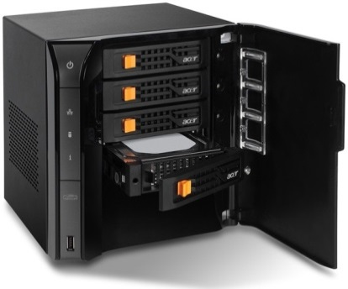

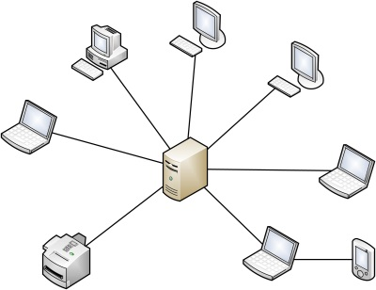
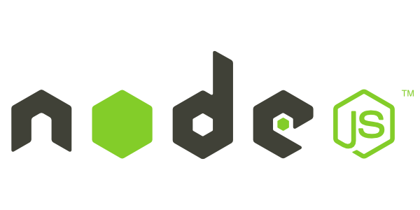
Introduction to NodeJS
What is the fuzz all about?
Telerik School Academy
Learning & Development
http://academy.telerik.com

Slide 2

Table of Contents
Overview of NodeJS
Building and installing NodeJS
Developing IDEs
What is the Event Loop?
Writing code with callbacks
Modules
Using modules
Installing modules

Slide 3

Overview of NodeJS

Slide 4
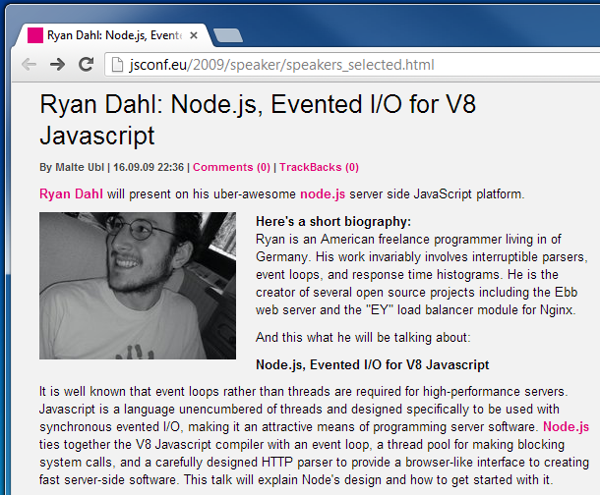
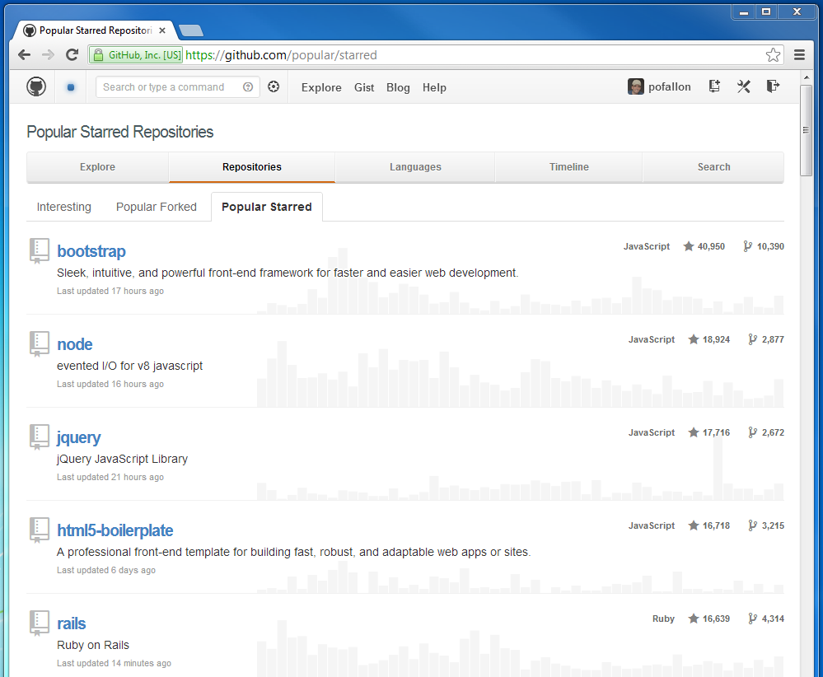
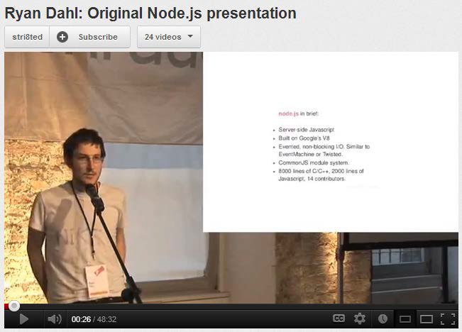
Overview of NodeJS
Background

Slide 5
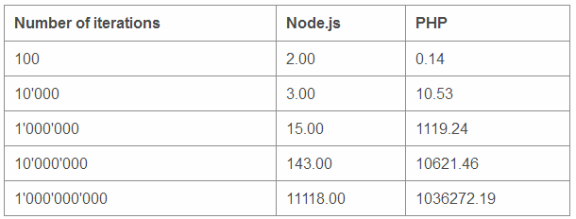
Why NodeJS
Node is written in JavaScript
One language on the server and the client
Full control of the server
Asynchronous and fast (callback oriented)

Slide 6
Building Blocks & Installation
NodeJS
libuv – high-performance event I/O library
V8 – Google Chrome's JavaScript engine
JavaScript -> C++
Installation
http://nodejs.org/
Run Command Prompt (cmd)
Type "node" and run it

Slide 7



Developing IDEs
IDEs
JetBrains WebStorm
Sublime Text 2/3
Cloud9

Slide 8
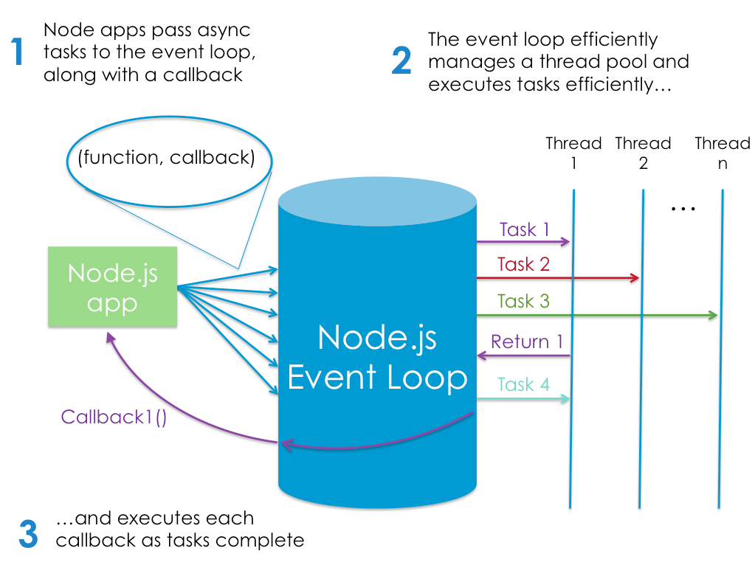
The Event Loop

Slide 9
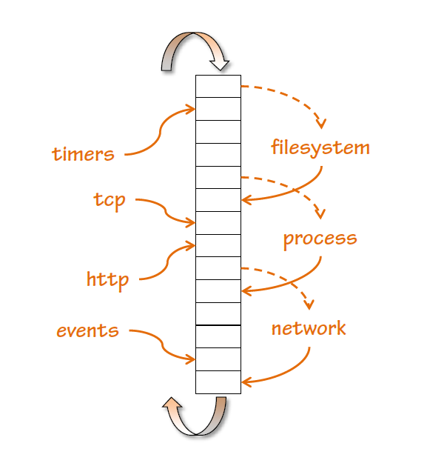
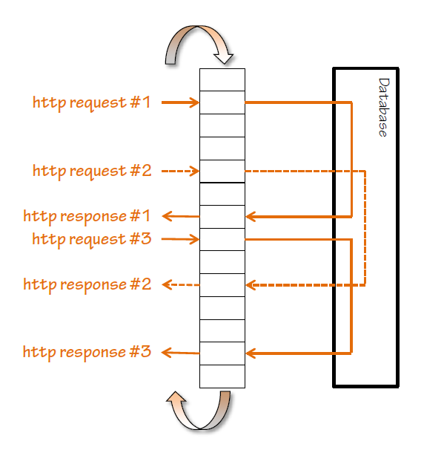
The Event Loop

Slide 10
Asynchronous Code
Standard way
Callback approach
var conn = getDbConnection(connectionString);
var stmt = conn.createStatement();
var results = stmt.executeQuery(sqlQuery);
for (var i=0; i<results.length; i++) {
// print results[i];
}
getDbConnection(connectionString, function(err, conn) {
conn.createStatement(function(err, stmt) {
var results = stmt.executeQuery(sqlQuery);
results.on(‘row’, function(result) {
// print result
});
});
});

Slide 11
Asynchronous Code
Standard way
Callback approach
var conn = getDbConnection(connectionString);
var stmt = conn.createStatement();
var results = stmt.executeQuery(sqlQuery);
for (var i=0; i<results.length; i++) {
// print results[i];
}
getDbConnection(connectionString, function(err, conn) {
conn.createStatement(function(err, stmt) {
var results = stmt.executeQuery(sqlQuery);
results.on(‘row’, function(result) {
// print result
});
});
});

Slide 12
Asynchronous Code
Convention
Callback is last parameter in the async call
Error is first parameter in the callback
var handleResults = function(error, results) {
// if error is undefined…
// do something with the results
}
getStuff(inputParam, handleResults);

Slide 13
Asynchronous Code
For simple uses – anonymous function
Closures are your friend
Do not overuse!
getStuff(inputParam, function(error, results) {
// if error is undefined…
// do something with the results
});
someOtherFunction(function(err, stuffToGet) {
var foo = 23;
getStuff(stuffToGet, function(error, results) {
// if error is undefined…
// do something with the results (and foo)
});
});

Slide 14
Asynchronous Code
Live Demo

Slide 15

Using Modules

Slide 16
Using Modules
Modules are used with "require"
var first = require('first');
var Second = require('second');
var justPart = require('largeModule').justPart;
var propertyResult = 2 + first.property; // export variable
var functionResult = first.function() * 3; // export function
var second = new Second(); // export object
console.log(justPart()); // export part of object

Slide 17
Built-in Modules
Built-in modules
Come with Node
Are "require"-ed with string identifier
Commonly used modules
fs, http, crypto, os
More at http://nodejs.org/api/
var fs = require('fs');

Slide 18
Built-in Modules
Live Demo

Slide 19
Your Modules
Each .js file is a different module
Are "require"-ed with file system semantics
".js" is not needed in the string
var data = require('./data'); // in same directory
var a = require('./other/a'); // in child directory
var b = require('../lib/b'); // in parent directory's child
var justPart = require(‘./data’).part; // just part of module

Slide 20
Your Modules
Variable are exported with module.exports
// first.js
var count = 2;
var doIt = function(i, callback) { … }
module.exports.doIt = doIt;
module.exports.someVar = 'result';
// second.js
var one = require('./first');
one.doIt(23, function (err, result) {
console.log(result);
});
console.log(one.someVar);
console.log(one.count); // invalid

Slide 21
Your Modules
Live Demo

Slide 22
Third-Party Modules
Third-Party Modules
Installed from Node Package Manager (NPM)
Command: "npm install mdl_name"
Are "require"-ed with string identifier
Some modules have command line tools
Command: "npm install –g mdl_name"
Example: Express, Mocha
var request = require('request');

Slide 23
Third-Party Modules
Live Demo

Slide 24
Resources
http://nodejs.org/ - NodeJS official web site
http://nodejs.org/api/ - API documentation
http://blog.nodejitsu.com/npm-cheatsheet - NPM documentation
https://npmjs.org/ - NPM official web site
https://github.com/felixge/node-style-guide - NodeJS style guide

Slide 25
Introduction to NodeJS
http://academy.telerik.com

